Slide 1
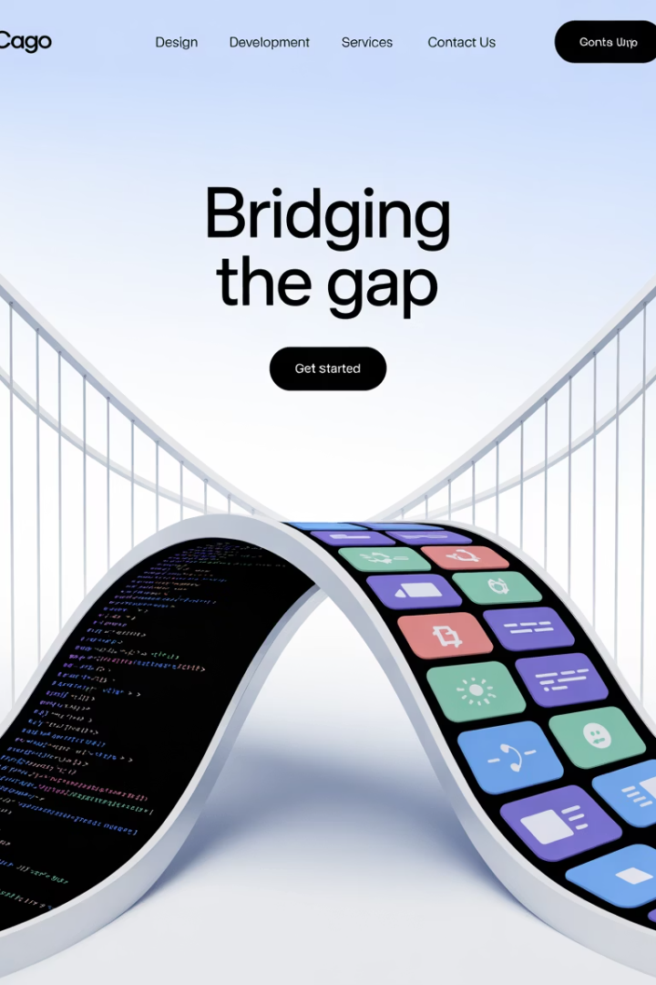
UI Development Accelerator
Manual UI implementation creates significant challenges for development teams. It consumes 40-60% of frontend development time, loses approximately 30% of design details during handoff, and introduces inconsistencies that undermine design system compliance.
These inefficiencies create bottlenecks when design changes occur and cost organizations between $120K-$180K annually in development resources. Traditional tools lack the deep understanding needed to generate production-ready code, often requiring extensive refactoring of basic snippets.
AS
by Advik Sarang

Slide 2








Bridging Design & Development
High Cost
$120K-$180K+ annually
Time Consumption
40-60% of frontend time
Design Fidelity Loss
~30% of details lost
Inconsistencies
Design system compliance issues
The manual translation of designs into code creates significant bottlenecks in the development process. When design changes occur, implementation backlogs grow quickly, further delaying product delivery and increasing costs. Traditional code generation tools provide only basic snippets that require substantial refactoring.

Slide 3
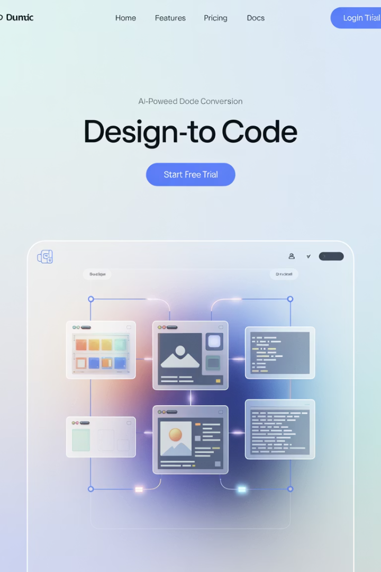




Our Vision: LLM-Powered UI Generation
Figma Design
Source of design truth
FigmaDev Plugin
Extracts comprehensive design data
AI Processing
Combines design data with requirements
Production Code
High-fidelity implementation
Our AI-Powered Design-to-Code Pipeline seamlessly connects Figma designs to production-ready code using Large Language Models. The FigmaDev Accelerator platform combines a smart Figma plugin with external AI processing to drastically reduce manual effort, ensure high fidelity, and accelerate development cycles.

Slide 4
FigmaDev Accelerator Workflow
Figma Plugin
AI Processing Engine
Intelligently extracts comprehensive design data directly within Figma's Dev Mode, including styles, layout, and tokens. This creates a structured Design Data Package that serves as the foundation for accurate code generation.
Takes the structured Design Data Package and combines it with User Stories/Requirements using LLMs (like Cursor AI) to generate sophisticated UI code that maintains design fidelity while implementing required functionality.
The Design Data Package is the key link in this workflow, providing rich, accurate context from Figma to the AI. This ensures that the generated code accurately reflects the designer's intent while incorporating the functionality specified in requirements.

Slide 5








Architecture Overview
Design Source
Data Extraction
Figma files with styles, components, and layout
Plugin captures high-fidelity design data
Code Generation
AI Enhancement
Production-ready UI implementation
LLMs process design data + requirements
The foundation of our approach is high-fidelity data extraction from the design source-of-truth. By leveraging LLMs with combined design data and user requirements, we enable intelligent code generation that maintains design integrity while implementing required functionality.
The key principle is that the plugin provides the exact, company-approved design elements as a robust foundation. This allows the AI to perform accurate "vibe coding" and generate high-quality, functional UI.

Slide 6

Plugin Architecture & Tech Stack
Figma Plugin API
Core interface for accessing design data, running inside Figma and interacting directly with the design file.
TypeScript
Preferred language for type safety with the API (JavaScript also possible), ensuring robust plugin development.
HTML / CSS
For building the optional plugin settings UI (ui.html), providing configuration options for users.
Node.js / npm
For development environment, build process, and managing dependencies efficiently.
The plugin architecture consists of core components including configuration, UI (optional), and the main code logic using Figma's API. A bundler (e.g., Webpack, esbuild) is often used to compile TypeScript/JavaScript and bundle code for Figma.

Slide 7
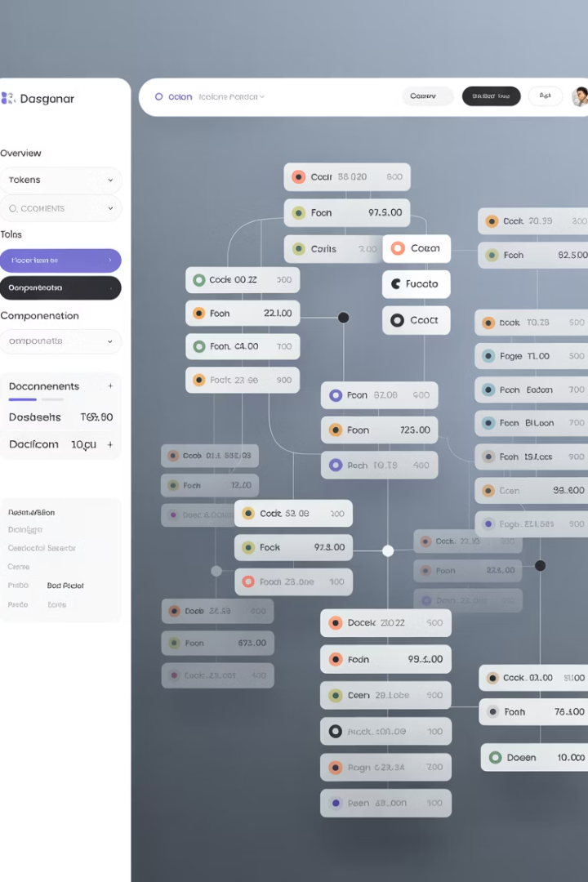
The AI Data Package
Metadata
General info about the extraction source
Structure
Element nesting and basic HTML structure
Styling
CSS rules and design tokens from Figma
Layout
Auto Layout details and constraints
Components
Figma component names and variants
This structured JSON package translates your Figma design into data the AI understands. It provides the essential context (styles, layout, structure) for accurate AI code generation, including design tokens for colors, typography, and spacing mapped directly from Figma Styles & Variables.
The package includes detailed CSS rules derived from Figma properties and information about Auto Layout settings such as direction, gap, and padding. This comprehensive data enables the AI to generate code that accurately reflects the design intent.

Slide 8




Transforming the Workflow
Developer Experience
Design Team Benefits
Technical Leadership Benefits
Shift focus from tedious CSS/HTML to valuable business logic with reduced friction and faster feedback loops with designers, leading to higher job satisfaction.
More creative freedom and iteration without dev bottlenecks, guaranteed implementation of the design system, and faster prototyping and validation cycles.
Reduced technical debt via consistent, maintainable UI code, enforced standards and best practices, and more predictable development timelines.
By revolutionizing the design-to-code workflow, the UI Development Accelerator creates significant benefits across the organization. Teams can initiate a 3-month pilot program to validate ROI in their specific context and begin seeing measurable impact within the first sprint.

